Slide 2
analyze the basics relating to concepts of clock.

Slide 3
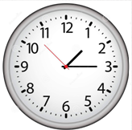
Concepts of Clock
Circumference - 60 equal parts
60 equal parts - Minute Spaces

Slide 4
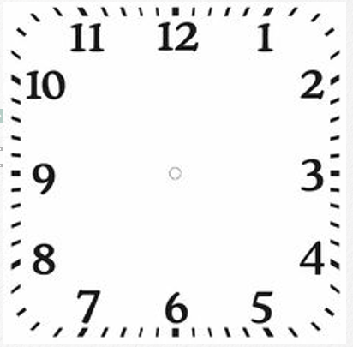
Concepts of Clock
Smaller Hand - Hour Hand/Short Hand
Larger Hand - Minute Hand/Long Hand
Thin long Hand - Second Hand

Slide 5
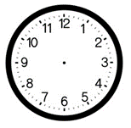
Concepts of Clock
Angle traced by minute hand in 60 min. = 360°
Angle traced by hour hand in 12 hrs. = 360°

Slide 6
Concepts of Clock
The minute hand moves 12 times as fast as the hour hand.

Slide 7
Concepts of Clock
The minute hand of clock gains 55 minutes on the hour hand of clock in 60 minutes.

Slide 8
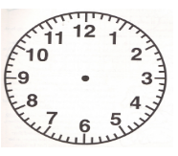

Concepts of Clock
In each minute
  The minute hand moves through 6°.

Slide 9
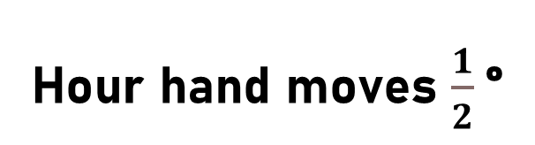
Concepts of Clock
  Hour hand moves $\frac{1}{2}$°

Slide 10

Concepts of Clock
In each minute
  The minute hand gains $5\frac{1}{2}$ ° than the hour hand.

Slide 11
Concepts of Clock
Both the hands of clock coincide once in every hour.

Slide 12
Concepts of Clock
The hands of the clock are coincident.
  Angle - 0°

Slide 13
Concepts of Clock
Both the hands of clock coincident or opposite to each other - Same straight line.

Slide 14
Concepts of Clock
The hands of the clock point in opposite directions.
  Angle – 180°

Slide 15
Concepts of Clock
The two hands of clock are 15 minute spaces apart
  Right Angle

Slide 16
Concepts of Clock
  The hands of a clock are twice at right angles
  - 15 minute spaces apart

Slide 17
Concepts of Clock
The two hands of clock are 30 minute spaces apart
- Opposite Directions

Slide 18
Concepts of Clock
Too Fast
  Clock indicates 12:15 & Correct time – 12
  Clock - 15 minutes too fast

Slide 19
Concepts of Clock
Too Slow
  Clock indicates 11:45 & Correct time – 12
  Clock - 15 minutes too slow

Slide 20
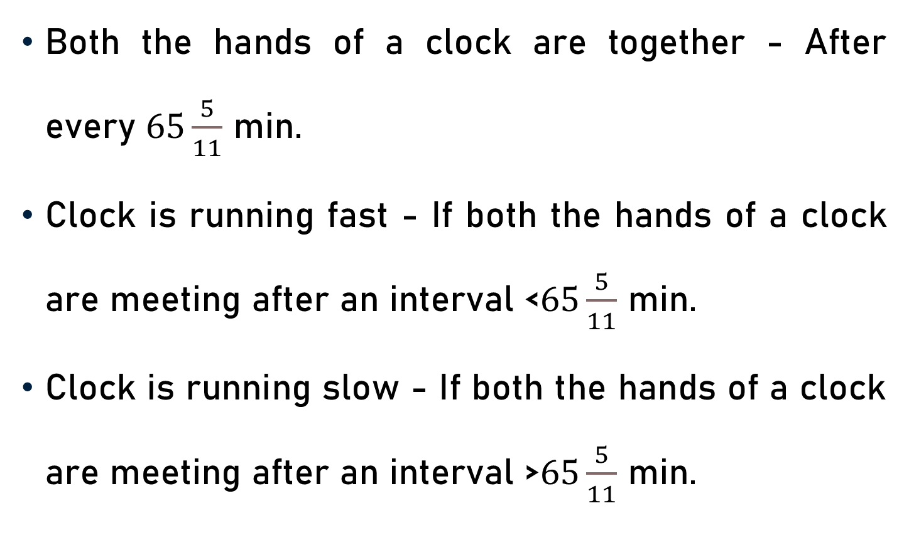
Concepts of Clock
Both the hands of a clock are together - After every $65\frac{5}{11}$ min.
Clock is running fast - If both the hands of a clock are meeting after an interval <$65\frac{5}{11}$ min.
Clock is running slow - If both the hands of a clock are meeting after an interval >$65\frac{5}{11}$ min.

Slide 21
Concepts of Clock
Interchange of Hands
  Whenever the hands of the clock interchange positions, the sum of the angles traced by hour hand and minute hand = 360°.

Slide 22
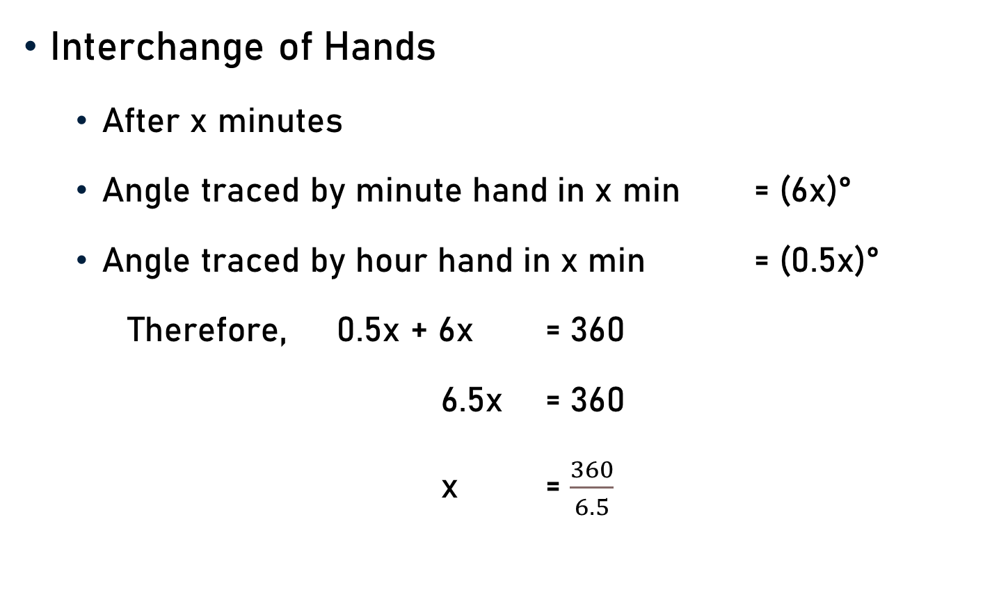
Concepts of Clock
Interchange of Hands
  After x minutes
  Angle traced by minute hand in x min = (6x)°
  Angle traced by hour hand in x min = (0.5x)°
  Therefore, 0.5x + 6x = 360
  6.5x = 360
  x = $\frac{360}{6.5}$

Slide 23
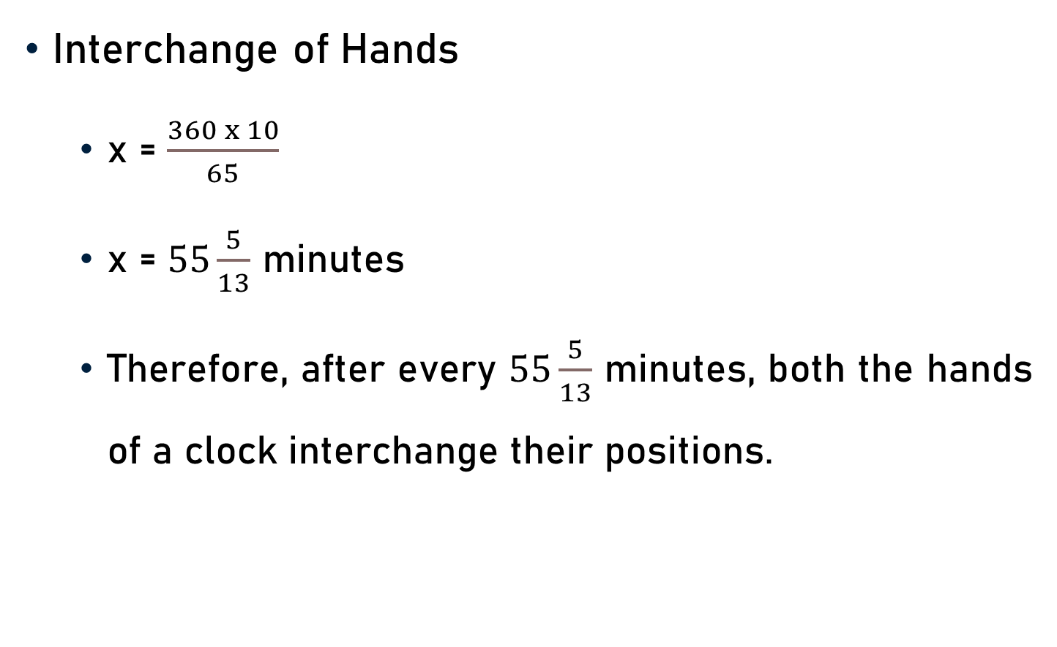
Concepts of Clock
Interchange of Hands
  x = $\frac{360 x 10}{65}$
  x = $55\frac{5}{13}$ minutes
  Therefore, after every $55\frac{5}{13}$ minutes, both the hands of a clock interchange their positions.

Slide 24
Conclusion
60 equal parts - Minute Spaces
Hour Hand & Minute Hand/Long Hand
In every hour
  Both the hands coincide once.
  Point in opposite directions once
  Twice at right angles.
  Whenever the hands of the clock interchange positions, the sum of the angles traced by hour hand & minute hand = 360°.

Slide 25
Summary
Concepts of Clock

